Slide 1
AIT-622 Group Project Data.gov
Rick
April 4, 2013
Technology Trends, Big Data and Data-Driven Decisions
Unclassified

Slide 2
Background
Rick
President Barack Obama’s direction on January 21, 2009 to have capabilities, or reasonable facsimiles, provided by such sites as Data.gov, OpenFEMA.gov, databank.worldbank.org, algorithmia.com, gigster.com, truefactor would potentially be useful to our “open environment”
Data.gov’s mission is “to ensure the public trust and establish a system of transparency, public participation, and collaboration.”
Our environment has attempted (several times) to establish scalable, enterprise-wide data and analytic capabilities
Our environment is investing heavily into cloud technologies

Slide 3
Purpose
Rick
Address issues related to:
Raw data being misinterpreted and misunderstood
Metadata not sufficiently scaling to meet Big Data challenges & opportunities
Data distribution systems are low priority, nonexistent, unreliable
Consumers not having consistent & centralized access to data
Security is not meshed effectively with data exchange environment
Data provisioning not leveraging tools and resources with Data Analytics and Data Science

Slide 4
Project Description
Rick
Fully leverage Open Source, commercial, and existing in-house capabilities to:
Provide consumers sufficient access to data and analytic
processing
Provide consumers sufficient collaboration and participatory capabilities with into the service development and delivery processes
Leverage security capabilities to support the advanced capabilities

Slide 5







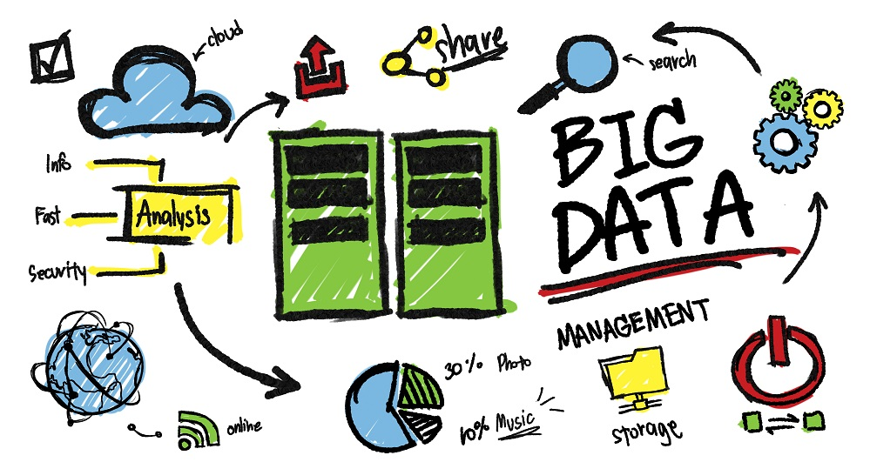
As-Is
Current Environment’s Problems
Rick
Agency A
Quality? What’s that?
User
GiGo
“metadata“ challenges
?
Raw data: misunderstood/misinterpreted
Agency B
X
Data provider give data in non-readable format.
Security: yes, no, maybe?
Data.Gov
Data distribution systems: low priority, nonexistent/unreliable
Agency D
No tools for you!
Agency C
Difficulties in offering high volume of data = unclear insight into government processes.

Slide 6
Phase 1 Requirements
Huong
Seq # | Requirement | Functional / Non-Functional? | Weight
1 | Data Lake will make data discoverable | Non-Functional | 8
2 | Data Lake will make data easily accessible | Non-Functional | 7
3 | Data Lake will provide access to raw and enriched data | Functional | 6
4 | Data Lake will store packaged data and recipes | Functional | 5
5 | Data Lake will provide a query-able catalog of data and services | Functional | 4
6 | Data Lake will accept requirements for new data sources | Functional | 3
7 | Data Lake Service will provide a REST API for accessing data | Functional | 2
8 | Data Lake Service will provide a Kafka based queing system to feed into FOSS analytic software and consumers' software | Functional | 1

Slide 7
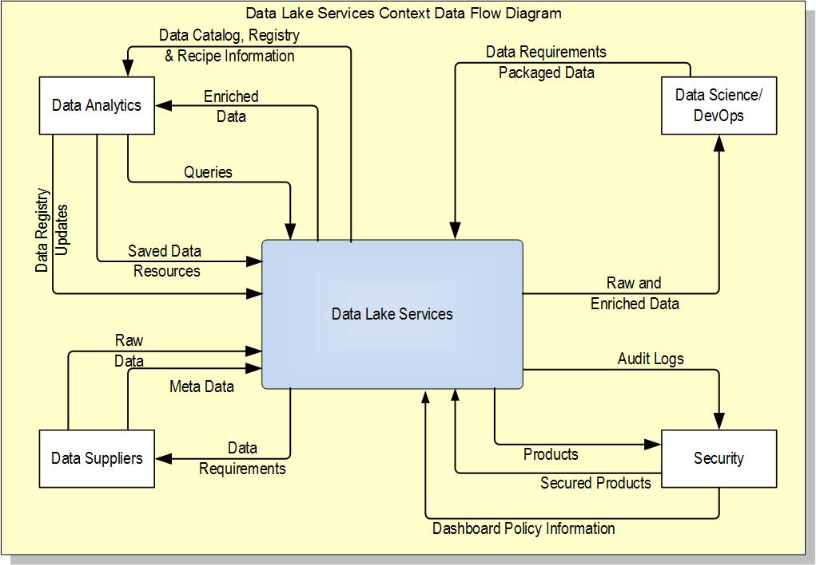
Proposed System Interfaces
Huong

Slide 8
Data Lake DFD-0
Huong

Slide 9
Alternatives’ Recommendation
Jeff
Storage Alternatives for Data Lake

Slide 10






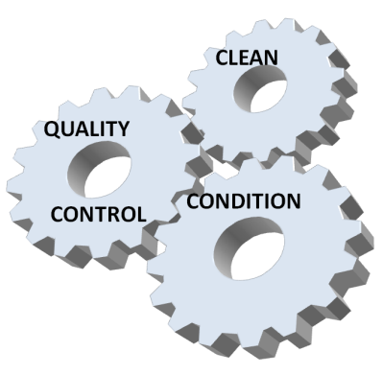



To-Be
Proposed Environment Solution(s)
Rick
Agency A
User
Social media/web tools
Data
Metadata
Agency B
Make raw data available in machine-readable format ready to be processed.
With access secured
Agency C
Data.Gov
Leverage data & analytic tools
Agency D
Open Source & Commercial

Slide 11
Project Schedule
Jeff
Short Term (12 months) | Mid Term (18 months) | Long Term (24 months)
Expose API interfaces | Provide multi-format data conversion services | Design publish and subscribe interface
Design data bus architecture | Design SOA contracts

Slide 12
Tangible Estimated Costs
Jeff
One-Time Costs | Recurring Costs
Engineering | Operations & Maintenance
Hardware & Software | Data Acquisition
Development & Implementation | Data Cleanup & Provisioning
Initial Standup

Slide 13
Estimated Benefits
Jeff
Tangible Benefits
Improved data quality & consistency
Reduced misinterpretations & misunderstandings
Intangible Benefits
Reduced impact on other Agencies
Better security
Better traceability (provenance & lineage)

Slide 14
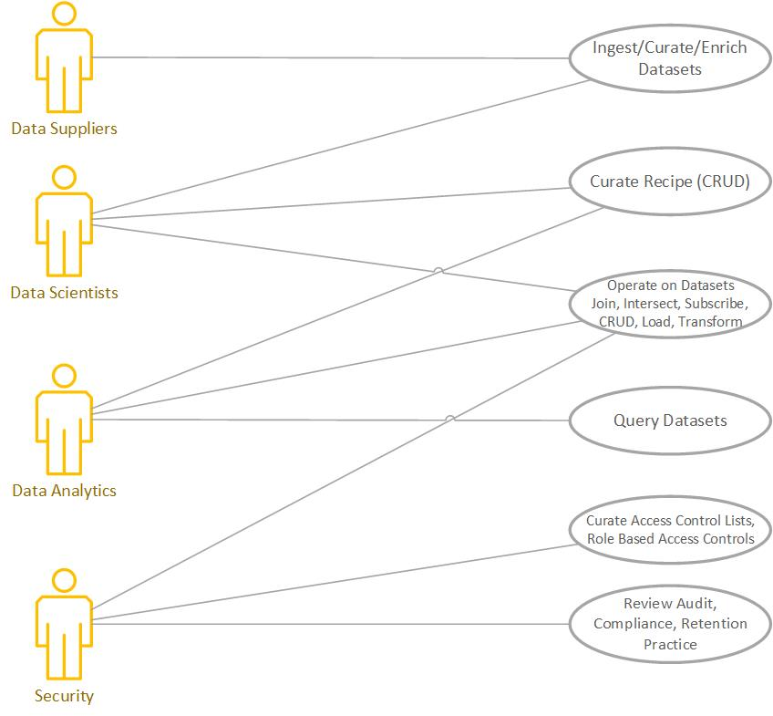
Use Cases
Huong

Slide 15
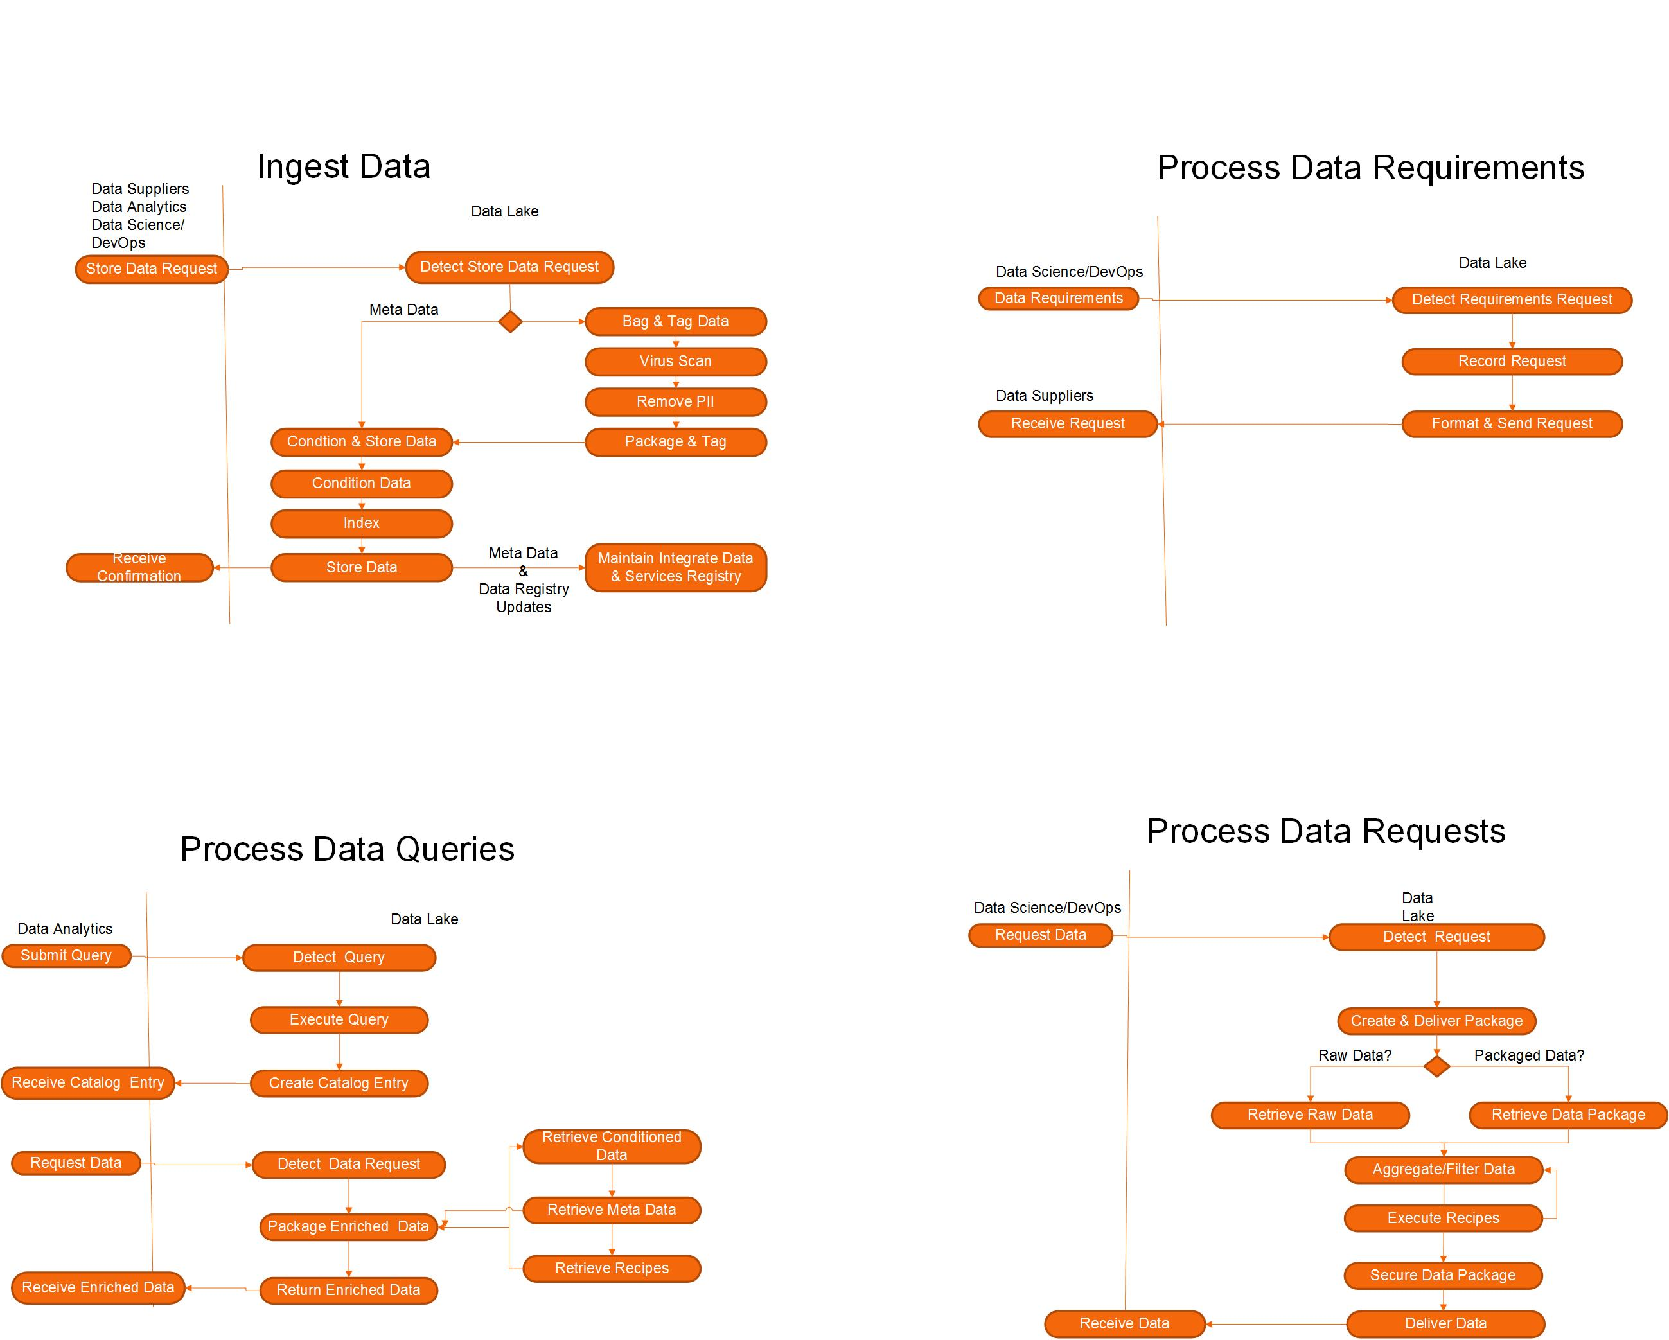
Proposed Operational Activities
Huong

Slide 16
Technical Sequencing of Functions
Huong
Sequence Diagram for Ingest Use Case:

Slide 17
Data Model
Huong

Slide 18
Data Model (continued)
Huong

Slide 19
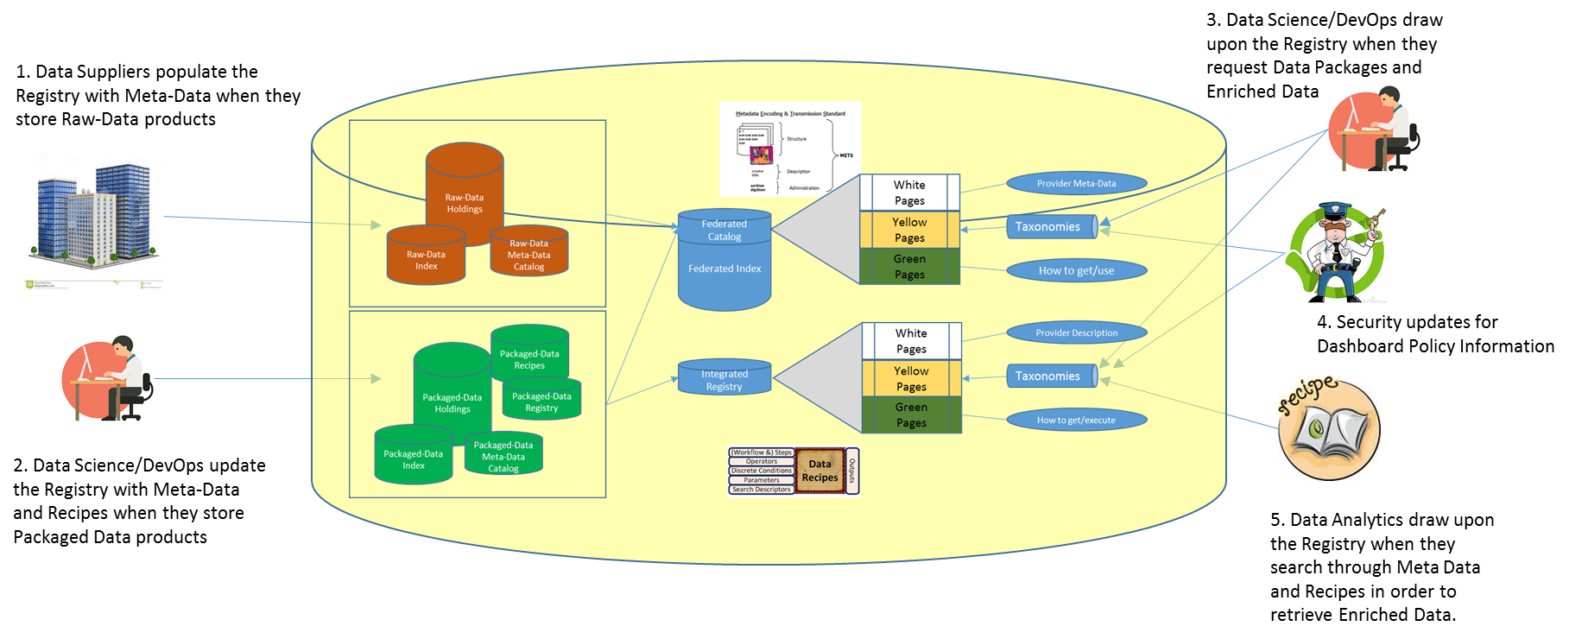
How Integrated & Data Services Registry Works
Mock-Up
Rick

Slide 20
Conclusions
Rick
Data Lake makes data both discoverable and accessible
Data Lake provides access to both raw and enriched data and to saved data packages
Data Lake also provides access to meta data and saved recipes which can be either retrieved or executed
It does this both reliably and securely.

Slide 21
Q&A
Presenter
?????

Slide 22
TMP Worksheet Only
Jeff
TMP # | Transition Message Point
1 | Reduce impediments to sharing by contributing agencies thereby increasing transparency
2 | Maintain pedigree and lineage to reduce misinterpretations and musunderstandings
3 | Provide data in multiple formats - both machine and human readable
4 | Promote metadata standards - provide translation service as part of conditioning for those who already have
5 | Improve data quality through data cleansing and conditioning
6 | Keep demands on contributing agencies to a minimum

Slide 23
Alternative Description
Jeff
Store All Data
Raw data is copied and ingested into Data Lake
Indexes are created and data is stored in Data Lake
Store Minimum
Indexes are copied to Data Lake
Raw data and meta data is stored on host agency’s systems
Hybrid
Based on SLA, raw data may be copied and ingested into Data Lake, or
Raw data and meta data is stored on host agency’s systems

